Slide 1
Checklist:
Users should have access to Zeppelin
  Email to confirm this is the case
Users should have access to Gitlab and a project to store queries going forward
Print out the common commands as a cheat sheet
  Commands
    http://www.sqltutorial.org/sql-cheat-sheet/
    https://github.com/enochtangg/quick-SQL-cheatsheet/blob/master/README.md
  Data Types
    See image saved H:\Data Services\Tools\SQL\data_types.png
Print out data model
Print out the end of session exercise & answers
Email to send course slides and zeppelin json for course and exercises.
Data set is available for user to access (added to the correct AD group)
Users are able to create temporary tables
Sample queries have been trialled and confirmed to work
Who is coming, which datasets are they interested in?

Slide 2
Introduction to SQL
Data Services

Slide 3
SQL Introduction
Objectives
By the end of the session you should be able to:
Access Zeppelin
Understand how to run queries in Zeppelin
Explain what SQL is
Understand why it’s useful
Understand how to start querying your own data independently or with the support of your colleagues (share common queries and output)

Slide 4
SQL Introduction
What is SQL?
SQL stands for Structured Query Language
SQL lets you access and manipulate databases
  Execute queries against a database
  Retrieve specified data from a database
  Create temporary tables to collect sub-sets of data
  User creation of Views disabled
  Read-only – cannot change the stored data
Huge wealth of knowledge and resources online

Slide 5
SQL Introduction
Getting Started – What is Zeppelin?
Zeppelin is a tool provided by Data Services to interrogate the data in the DS Hub.
It is a web-based notebook that enables interactive data analytics.
Login to Zeppelin – network username & password = your account
Create a notebook – give it a directory\name
Interpreter – jdbc
Put in some explanatory text
    %md
    # Liz Play - Single hash
    ## Double hash
    ### Triple hash
Execute – shift & enter or Arrow symbol
Zeppelin limit 1K currently, increasing 10K soon
Lets you display your results as graphs

Slide 6

SQL Introduction
Getting Started – Database Architecture
A database will contain one or more tables.
Each table is identified by a name (e.g. Customers, Suppliers, etc)
Tables contain records (rows) with data.
The table above contains:
A hearer row to name each of the data items
4 records, one row for each person listed
5 columns

Slide 7
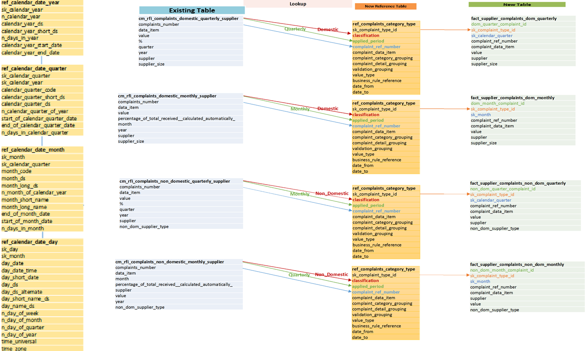
SQL Introduction
Getting Started – Database Architecture
Notes:
See Complaints Data Model - Complaints Data Model.docx . Starting point for analysing datasets; tables and fields available; how tables join

Slide 8
SQL Introduction
Getting Started – Database Architecture
Database – cm_rfi
Tables
  cm_rfi_complaints_domestic_monthly_supplier
  cm_rfi_complaints_domestic_quarterly_supplier
  cm_rfi_complaints_non_domestic_monthly_supplier
  cm_rfi_complaints_non_domestic_quarterly_supplier
Attributes or Fields (data_item)
  complaints_number
  value
  supplier
Data Type
  String
  Integer (whole number)
  Double (floating point number / decimal)
  Date
  Boolean (true or false)
  null (no value/none)
Notes:
See data_types.png

Slide 9

SQL Introduction
Getting Started – Basic Commands
To interact with the data in the database you execute SQL statements.
Query - Explore | Example
%jdbc(hive_interactive) show databases;
%jdbc(hive_interactive) use database_name; | %jdbc(hive_interactive) use cm_rfi;
%jdbc(hive_interactive) use database_name; show tables; | %jdbc(hive_interactive) use cm_rfi; show tables;
%jdbc(hive_interactive) desc/describe table_name; | %jdbc(hive_interactive) use cm_rfi; desc cm_rfi_complaints_domestic_quarterly_supplier;
What is the data type of the ‘year’ field, in the table ‘cm_rfi_complaints_domestic_monthly_supplier’?
Notes:
Must always start with interpreter line %jdbc(hive_interactive)
Only need to state ‘use dbname’ for first time; will continue to use that dbase unless you explicitly change it.
Can run > 1 command if separate by semi-colon.

Slide 10
SQL Introduction
Getting Started – Basic Commands
Query - Explore | Example
%jdbc(hive_interactive) use database_name; SELECT * FROM table_name LIMIT number_rows; | %jdbc(hive_interactive) use cm_rfi; SELECT * FROM cm_rfi_complaints_domestic_monthly_supplier LIMIT 50;
%jdbc(hive_interactive) SELECT column1, column3, …….. FROM table_name; | %jdbc(hive_interactive) SELECT supplier, data_item, value FROM cm_rfi_complaints_domestic_monthly_supplier LIMIT 50;
%jdbc(hive_interactive) SELECT DISTINCT (column1) FROM table_name; | %jdbc(hive_interactive) SELECT supplier FROM cm_rfi_complaints_domestic_monthly_supplier LIMIT 50; SELECT DISTINCT (supplier) FROM cm_rfi_complaints_domestic_monthly_supplier;
Can you return a list of distinct suppliers and their corresponding size?
Notes:
SQL Server = TOP; MySQL, Postgres Use LIMIT
LIMIT gets full dataset and displays the x rows to the limit, TOP only select the top x rows.

Slide 11
SQL Introduction
Getting Started – Operators
Operators are used to filter the dataset to only return the records that meet the specified condition(s).
Conditions are specified in the WHERE clause that we will come onto next.
NB: CONCAT() & SUBSTRING are string manipulators not really operators but included here to ensure covered. Examples:
CONCAT(x, ‘ ‘, y) would result in “x y”.
substring(“hello world”,4,6) would result in “lo wor”
Comparison
Operator | Description
= | Equal to
> | Greater than
< | Less than
>= | Greater than or equal to
<= | Less than or equal to
!= | Not equal to
<> | Not equal to
Comparison
Operator | Description
= | Equal to
> | Greater than
< | Less than
>= | Greater than or equal to
<= | Less than or equal to
!= | Not equal to
<> | Not equal to

Slide 12
SQL Introduction
Getting Started – Operators
Logical
Operator | Description
ALL | TRUE if all of the subquery values meet the condition
AND | TRUE if all the conditions separated by AND is TRUE
ANY | TRUE if any of the subquery values meet the condition
BETWEEN | TRUE if the operand is within the range of comparisons
EXISTS / NOT EXISTS | TRUE if the subquery returns one or more records
IN | TRUE if the operand is equal to one of a list of expressions
LIKE | TRUE if the operand matches a pattern
NOT/NOT IN | Displays a record if the condition(s) is NOT TRUE
OR | TRUE if any of the conditions separated by OR is TRUE
SOME | TRUE if any of the subquery values meet the condition

Slide 13
SQL Introduction
Basic Commands – where, order by
Example
SELECT column1, column3, …….. FROM table_name WHERE column 3 = value ORDER BY column1; *note Order by default is lowest-highest; A-Z
SELECT supplier, complaints_number, data_item FROM cm_rfi_complaints_domestic_monthly_supplier WHERE complaints_number = ‘B5’; *note: copy/paste quotes changes to wrong quotes; must type. Use ‘’ or “”
SELECT supplier, CONCAT(complaints_number, ‘ – ‘, data_item), month, year FROM cm_rfi_complaints_domestic_monthly_supplier WHERE year = 2019; *note: numbers do not need quotes
SELECT supplier, complaints_number, data_item FROM cm_rfi_complaints_domestic_monthly_supplier WHERE complaints_number = ‘B5’ ORDER BY supplier desc;
SELECT supplier, complaints_number, data_item, month, year FROM cm_rfi_complaints_domestic_monthly_supplier WHERE month != ‘December’;

Slide 14
SQL Introduction
Basic Commands – wildcards
Wildcards can be used to select all data in a table “*” or where we do not know the full string. Common wildcards are: “*”, “%” and “_”. The work LIKE can also be used.
Inherent reduction of performance using wildcards
Example
SELECT * FROM cm_rfi_complaints_domestic_monthly_supplier LIMIT 100;
SELECT supplier, complaints_number, data_item FROM cm_rfi_complaints_domestic_monthly_supplier WHERE complaints_number like ‘B_’;
SELECT supplier, complaints_number, data_item FROM cm_rfi_complaints_domestic_monthly_supplier WHERE data_item like ‘B%’;

Slide 15
SQL Introduction
Basic Commands – and, or, not
Example
SELECT column1, column3, …….. FROM table_name WHERE column 1 = value AND/OR column 3 = value
SELECT supplier, complaints_number, data_item FROM cm_rfi_complaints_domestic_monthly_supplier WHERE complaints_number = ‘B5’ AND supplier_size = ‘Large’;
SELECT CONCAT(supplier, ‘ - ‘,supplier_size ), complaints_number, data_item FROM cm_rfi_complaints_domestic_monthly_supplier WHERE complaints_number = ‘B5’ AND (supplier_size = ‘Large’ OR supplier_size = ‘Medium’); WHERE complaints_number != ‘B5’ WHERE complaints_number <> ‘B5’
SELECT supplier, complaints_number, data_item FROM cm_rfi_complaints_domestic_monthly_supplier WHERE complaints_number in(‘A1’, ‘B5’, ‘C24’) WHERE complaints_number not in(‘A1’, ‘B5’, ‘C24’) ORDER BY complaints_number;
SELECT supplier, complaints_number, data_item, month, year FROM cm_rfi_complaints_domestic_monthly_supplier WHERE year >= 2019; WHERE year <= 2019; WHERE year < 2019; WHERE year != 2019;
Can you return a list of distinct suppliers who have had type A4 complaints in 2019 and are either small or very small in size.
Notes:
%jdbc(hive_interactive)
SELECT distinct supplier, complaints_number, year, supplier_size
FROM cm_rfi_complaints_domestic_monthly_supplier
WHERE complaints_number = 'A4'
AND year = 2019
AND supplier_size = 'Large';

Slide 16
SQL Introduction
Basic Commands – nulls
NULL represents a missing or unknown values.
Sometimes you want to identify the records that have missing values so you can assess if they are a problem, other times you only want records that do not have missing values.
Example
SELECT column1, column3, …….. FROM table_name WHERE column 1 is NULL AND/OR column 3 is not NULL
SELECT supplier, complaints_number, data_item, value FROM cm_rfi_complaints_domestic_monthly_supplier WHERE value is NULL; WHERE value is not NULL;

Slide 17
SQL Introduction
Basic Commands – aggregation
There are many calculation type functions that can be used in SQL.
The most common are: count, avg, sum, min and max.
Example
SELECT count(), sum(), avg(), min(), max() FROM table_name GROUP BY column 1
SELECT count(*) /* number of rows in the table */ FROM cm_rfi_complaints_domestic_monthly_supplier;
SELECT supplier, complaints_number, data_item, sum(value) /* number of complaints */ FROM cm_rfi_complaints_domestic_monthly_supplier GROUP BY supplier, complaints_number, data_item;
SELECT supplier, complaints_number, data_item, int(sum(value)) /* cast as int - round down */ FROM cm_rfi_complaints_domestic_monthly_supplier WHERE year = 2018 AND month = 'December' AND supplier_size = 'Large' GROUP BY supplier, complaints_number, data_item;
SELECT complaints_number, int(avg(value)) FROM cm_rfi_complaints_domestic_monthly_supplier WHERE year = 2018 GROUP BY complaints_number ORDER BY complaints_number;
SELECT complaints_number, sum(value), avg(value), min(value), max(value) FROM cm_rfi_complaints_domestic_monthly_supplier WHERE year = 2018 GROUP BY complaints_number ORDER BY complaints_number;

Slide 18
SQL Introduction
Basic Commands – alias
Particularly useful with aggregates but can be used to rename column outputs and tables
Example
SELECT column1 AS customName, ‘static_text’ AS my_id FROM table_name;
SELECT supplier, complaints_number, data_item, int(sum(value)) AS number_complaints FROM cm_rfi_complaints_domestic_monthly_supplier GROUP BY supplier, complaints_number, data_item ORDER BY supplier, complaints_number, data_item;
SELECT “Rows in Table” AS rows_in_table, count(*) AS number_of_submissions FROM cm_rfi_complaints_domestic_monthly_supplier GROUP BY supplier, complaints_number, data_item;
SELECT complaints_number AS key, sum(value) AS total_value, avg(value) AS avg_value, min(value) AS min_value, max(value) AS max_value FROM cm_rfi_complaints_domestic_monthly_supplier WHERE year = 2018 GROUP BY complaints_number ORDER BY complaints_number;

Slide 19
SQL Introduction
Basic Commands – sub selects
Example
SELECT column1, column3, …….. FROM table_name WHERE column 1 in ( SELECT column 2 FROM table_name2 WHERE column5 = value)
/* Supplier Domestic B8 not got corresponding Non Domestic */ SELECT DISTINCT supplier, complaints_number, data_item, month, year FROM cm_rfi_complaints_domestic_monthly_supplier WHERE year = 2019 AND complaints_number = “B8” AND supplier not in( SELECT DISTINCT(supplier) FROM cm_rfi_complaints_non_domestic_monthly_supplier WHERE year = 2019 AND complaints_number = 'B8') ORDER BY supplier, year, month;
/* Supplier has complaint, not active in Supplier List */ SELECT DISTINCT supplier FROM cm_rfi_complaints_domestic_monthly_supplier WHERE supplier NOT IN ( SELECT DISTINCT(supplier) FROM retail_ref_supplier_scd_all WHERE `end` = ‘2050-12-31’);

Slide 20
SQL Introduction
Basic Commands – having vs where
Where = dimension e.g. region, supplier
Having = aggregation e.g. count/sum – filters after aggregation (slow)
SQL aggregate functions can’t be used in a WHERE clause.
Use Having Clause instead – great for finding duplicates / error checking!
Invalid | Valid
SELECT complaints_number, sum(value) FROM cm_rfi_complaints_domestic_monthly_supplier WHERE sum(value) > 100 GROUP BY complaints_number; | SELECT complaints_number, sum(value) FROM cm_rfi_complaints_domestic_monthly_supplier GROUP BY complaints_number HAVING sum(value) > 100;
/* Supplier has submitted more than once in the same month */ SELECT supplier, year, month, complaints_number, count(*) FROM cm_rfi_complaints_domestic_monthly_supplier GROUP BY supplier, year, month, complaints_number HAVING count(*) > 1
Are there any duplicate active suppliers in the suppliers table (retail_ref_supplier_scd_all)? If yes why is this, what makes them a duplicate?
Notes:
e.g. errors by supplier spark submitting decimals!

Slide 21
SQL Introduction
Basic Commands – joins
When you want to retrieve information from more than one table you must have a unique value/identifier in each table to allow the retrieval to a single record.
Note: this example show that there are many mpids per supplier in the retail_ref_supplier_scd_all table.
Example
SELECT a.field1, a.field2, b.field1 FROM table_name1 a, table_name2 b WHERE a.field1 = b.field5; *note use of alias to simplify statement
SELECT DISTINCT a.supplier, b.mpid FROM cm_rfi_complaints_domestic_monthly_supplier a, retail_ref_supplier_scd_all b WHERE a.supplier = b.supplier AND b.`end` = '2050-12-31' ORDER BY a.supplier;

Slide 22
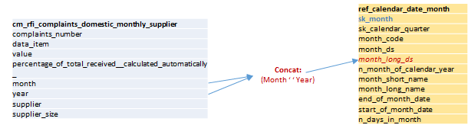
SQL Introduction
Basic Commands – joins
First look at the tables to identify your unique join key (desc ref_master_data.ref_calendar_date_month)
Identify the field(s) you could use to join the tables
Check that these are unique – else return a row for each match. This could mean 1 row in the core table becomes > 1 row in joined results.
/* Join to the monthly calendar table to enable sorting by calendar date - January – December */
SELECT a.supplier, a.complaints_number, a.data_item, b.start_of_month_date, a.value
FROM cm_rfi_complaints_non_domestic_monthly_supplier a,
ref_master_data.ref_calendar_date_month b
WHERE CONCAT(a.month, ' ', a.year) = b.month_long_ds
ORDER BY a.supplier, b.start_of_month_date, a.complaints_number;

Slide 23
SQL Introduction
Basic Commands – joins
Join to the date tables to allow ordering by calendar month – otherwise will order by month alphabetically.
/* Complaints by month – total C26 each month */
SELECT a.month AS month, a.supplier_size, int(sum(value)) AS total_monthly_complaints
FROM cm_rfi_complaints_domestic_monthly_supplier a,
ref_master_data.ref_calendar_date_month b
WHERE a.complaints_number = ‘C26'
AND a.year = 2018
AND CONCAT(a.month, ' ', a.year) = b.month_long_ds
GROUP BY b.n_month_of_calendar_year, a.month, a.supplier_size
ORDER BY b.n_month_of_calendar_year, a.supplier_size;
* See next slide to demo graph prior to completing question.
Note: C26 = multiplies complaints by 100,000 to allow more meaningful comparison between different sized suppliers.
Can you adapt this query to show monthly complaints (use the monthly table) totalled up by quarter, in quarter order, and display it as a zeppelin graph?
Notes:
Question – all months would mean remove year qualifier and add year to select and ordering.

Slide 24
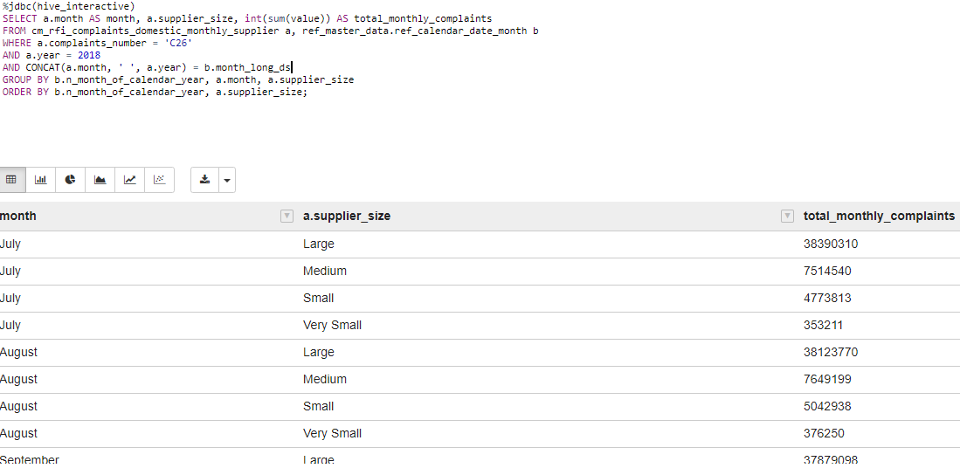
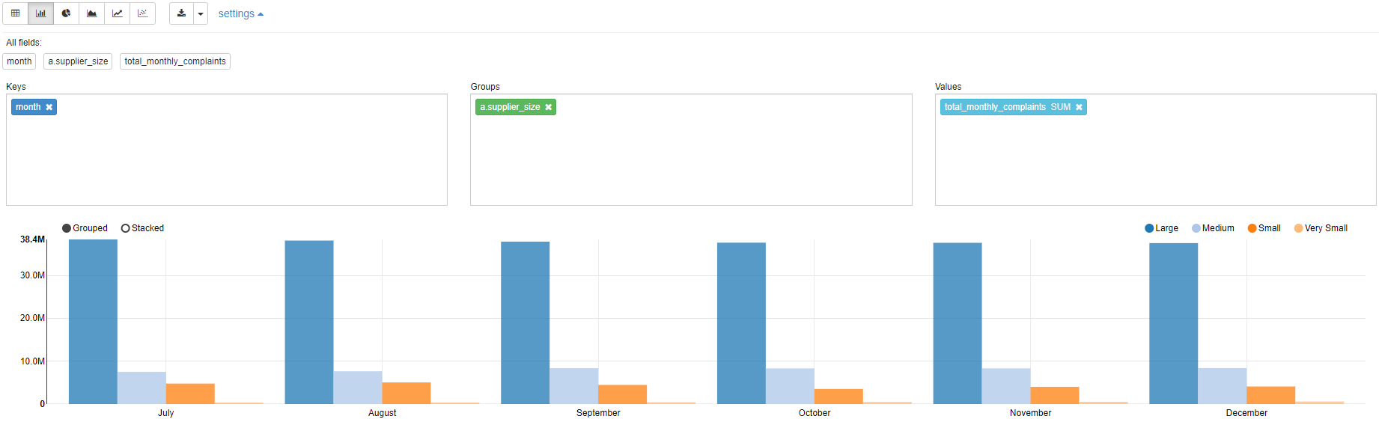
SQL Introduction
Basic Commands – graphs in Zeppelin
Keys = x-axis
Values = y-axis
Groups = dimensions to compare
Toggle between Grouped and Stacked
Toggle between graph types
Line can select to force start y-axis at 0
Line can select to show line with focus – useful for large dimension sets

Slide 25
SQL Introduction
Basic Commands – temporary table
Only you can see any temporary table that you create
Only exists in the current session; is dropped when you log out
Can create temp table then update it with supplementary data
Start by refining the SELECT statement that will be used to initially populate the temp table
Include named columns with no data to update after table creation
When the SELECT is correct then pre-pend the SELECT statement with the CREATE statement:
  CREATE TEMPORARY TABLE table_name AS
  SELECT …………
Syntax
CREATE TEMPORARY TABLE table_name AS SELECT field1, field2, field3, ‘’ AS string_field_name, 0 AS numeric_field_name, 0.0 AS double_field_name FROM table_name2;
UPDATE table_name a FROM table_name2 b SET string_field_name = ‘value’, numeric_field_name = count(*), double_field_name = b.field5 WHERE a.id = b.id GROUP BY b.field1;

Slide 26
SQL Introduction
Basic Commands – temporary table
Create a temporary table with a full list of suppliers.
Update this table for 2018 Q4 to compare the cumulative monthly totals for the quarter with the reported quarter totals.
Example
CREATE TEMPORARY TABLE quarter_2018Q4_compare AS SELECT DISTINCT supplier AS supplier, 0 AS quarterly_totals_from_month, 0 AS quarterly_totals_reported FROM retail_ref_supplier_scd_all;
UPDATE quarter_2018Q4_compare a FROM cm_rfi_complaints_domestic_monthly_supplier b SET quarterly_totals_from_month = int(sum(b.value)) WHERE a.supplier = b.supplier AND b.year = 2018 AND b.month in ('October', 'November', 'December') GROUP BY b.supplier, b.year;
UPDATE quarter_2018Q4_compare a FROM cm_rfi_complaints_domestic_quarterly_supplier b SET quarterly_totals_reported = int(sum(b.value)) WHERE a.supplier = b.supplier AND b.year = 2018 AND b.quarter = 'December' GROUP BY b.supplier, b.year;

Slide 27
SQL Introduction
Basic Commands – hints & tips
Incrementally build your query – easier to break down and troubleshoot
Comment your Code!
  before code cell/block Mark Down = %md
  %md
  #Complaints
  within code; single line --
  -- where column = value
  -- using this where clause because
  within code; multiple lines /* …. */
  /* this where clause is to ensure bla bla
  bla bla */
Escape out key words where they are field names
  SELECT `date` FROM table & SELECT b.`end` FROM….
  note: this is the single angled quote on the top left key
Copy & paste into Zeppelin will reformat your quotes (“” & ‘’); you must over-type these in Zeppelin or will error.
Notes:
Within zeppelin the comment lines will be coloured differently.
Great for allowing you to try out different things without having to re-type code.
Good if particularly complex to explain to your future self why you did what you did!

Slide 28
SQL Introduction
On slide questions - answers
What is the data type of the ‘year’ field, in the table ‘cm_rfi_complaints_domestic_monthly_supplier’?
  int
Select distinct supplier and their size from cm_rfi_complaints_domestic_monthly_supplier;
  %jdbc(hive_interactive)
  SELECT DISTINCT (supplier), supplier_size
  FROM cm_rfi_complaints_domestic_monthly_supplier;
Can you return a list of distinct suppliers who have had type A4 complaints in 2019 and are either small or very small in size.
  %jdbc(hive_interactive)
  SELECT DISTINCT (supplier), complaints_number, data_item, supplier_size
  FROM cm_rfi_complaints_domestic_monthly_supplier
  WHERE complaints_number = 'A4'
  AND year = 2019
  AND (supplier_size = 'Small' OR supplier_size = 'Very Small');
Are there any duplicate active suppliers in the suppliers table (retail_ref_supplier_scd_all)? If yes why is this, what makes them a duplicate?
  %jdbc(hive_interactive)
  SELECT supplier, count(supplier)
  FROM retail_ref_supplier_scd_all
  WHERE `end` = '2050-12-31‘
  GROUP BY supplier
  HAVING COUNT(*) > 1;
  Different MPIDs e.g. SELECT * FROM retail_ref_supplier_scd_all WHERE supplier = 'npower';

Slide 29
SQL Introduction
On slide questions - answers
Adapt query to show total complaints each month, in month order, and display it as a zeppelin graph %jdbc(hive_interactive)
  SELECT a.month AS month, count(*) as total_monthly_complaints
  FROM cm_rfi_complaints_domestic_monthly_supplier a, ref_master_data.ref_calendar_date_month b
  WHERE a.complaints_number = 'A1'
  AND a.year = 2018
  AND CONCAT(a.month, ' ', a.year) = b.month_long_ds
  GROUP BY b.n_month_of_calendar_year, a.month
  ORDER BY b.n_month_of_calendar_year;

Slide 30
SQL Introduction
Course – exercise
Find missing data in the monthly domestic
  How many records do not have a ‘value’
  Compile an alphabetical list of suppliers who do not have a ‘percentage_of_total_received__calculated_automatically_’ with the number of records that do not have a percentage recorded.
Find any duplicates in the monthly domestic dataset – list out supplier, complaints_number, data_item, year, month and sort the list by this order.
Repeat 1a) for those that do have a value recorded, name the supplier, give the calculated column an alias and also list out the total amount of the value for each.
Change 3. to only display where the total amount of the value is greater than 0. (Use HAVING)
Can you return a list of distinct suppliers together with the total number of non domestic quarterly complaints handled by an agent in each quarter? You should give calculated columns suitable names and ensure the list is sorted by supplier and quarter. Only include complaints where the calculated total is 200 or more.
List out all the distinct suppliers together with the total number of their domestic complaints in each month. The list should be order by calendar month from January – December.
Adapt one of the queries above to create a temporary table and then update this table with some calculated and static values e.g. sum(values), strings = ‘test string’, value from another table.

Slide 31
SQL Introduction
Exercise – sample answers
Remember lots of ways to get the same results – answers here are just samples!
%jdbc(hive_interactive)
/* 1a. Find missing data in the monthly domestic; How many records do not have a ‘value’ */
SELECT count(*)
FROM cm_rfi_complaints_domestic_monthly_supplier
WHERE value is null;
/* 1b. Find missing data in the monthly domestic; Compile an alphabetical list of suppliers who do not have a ‘percentage_of_total_received__calculated_automatically_’ with the number of records that do not have a percentage recorded. */
SELECT supplier, count(*) as number
FROM cm_rfi_complaints_domestic_monthly_supplier
WHERE percentage_of_total_received__calculated_automatically_ is null
GROUP by supplierORDER BY supplier;
%jdbc(hive_interactive)
/* 2. Find any duplicates in the monthly domestic dataset – list out supplier, complaints_number, data_item, year, month and sort the list by this order. */
SELECT supplier, complaints_number, data_item, year, month, count(*) as number
FROM cm_rfi_complaints_domestic_monthly_supplier
GROUP BY supplier, complaints_number, data_item, year, month
HAVING count(*) > 1
ORDER BY supplier, complaints_number, data_item, year, month;
%jdbc(hive_interactive)
/* 3. Repeat 1a) for those that do have a value recorded, name the supplier, give the calculated column an alias and also list out the total amount of the value for each. */
SELECT supplier, count(*) as total, sum(value) as total_amount
FROM cm_rfi_complaints_domestic_monthly_supplier
WHERE value is not null
GROUP by supplier, value;

Slide 32
SQL Introduction
Exercise – sample answers
%jdbc(hive_interactive)
/* 4. Change 3. to only display where the total amount of the value is greater than 0. */
SELECT supplier, count(*) as total, sum(value) as total_amount
FROM cm_rfi_complaints_domestic_monthly_supplier
WHERE value is not null
GROUP by supplier, value
HAVING sum(value) > 0;
%jdbc(hive_interactive)
/* 5. List of distinct suppliers together with the total number of non domestic quarterly complaints handled by an agent in each quarter and the total values of those complaints? You should give calculated columns suitable names and ensure the list is sorted by supplier and quarter. Only include complaints where the calculated value is 200 or more. */
SELECT a.supplier, a.year, a.quarter, sum(a.value) AS agent_handled_complaints
FROM cm_rfi_complaints_non_domestic_quarterly_supplier a
WHERE a.data_item like '%Agent%' or a.data_item like '%agent%‘
GROUP BY a.supplier, a.year, a.quarter
HAVING sum(a.value) >= 200
ORDER BY a.supplier, a.year, a.quarter;
%jdbc(hive_interactive)
/* 6. List out all the distinct suppliers together with the total number of their domestic complaints in each month. The list should be order by calendar month from January – December. */
SELECT a.supplier, a.month AS month, int(sum(value)) AS total_monthly_complaints
FROM cm_rfi_complaints_domestic_monthly_supplier a, ref_master_data.ref_calendar_date_month b
WHERE a.complaints_number = 'A1‘
AND a.year = 2018
AND CONCAT(a.month, ' ', a.year) = b.month_long_ds
GROUP BY a.supplier, b.n_month_of_calendar_year, a.month
ORDER BY a.supplier, b.n_month_of_calendar_year, a.month;

Slide 33
SQL Introduction
Next Steps
SQL Intermediate Class
Python Introduction
BI Training
Data Services can support
Self Help
Datacamp – https://www.datacamp.com/courses/tech:sql/q:sql
W3 Schools - https://www.w3schools.com/sql/
Use google (StackOverFlow is good) you can bet somebody has done it before!

Slide 34
How to get in touch …
In person:
London (N4) Glasgow (by the Steamie)
E-mail: DataServicesSupport@ofgem.gov.uk
Through the helpdesk:
www.ofgem-dataservices.support

Slide 35
Get Involved – All Welcome
Stand-ups at Speaker Corner
Next Show & Tell
Work recorded in Confluence
Mon – Fri @ 9:15am
08 May 2019 @ 3pm
https://ofgemsousd.atlassian.net/wiki/spaces/ODS/overview
Show and Tell slides are on The Wire

